Slide 1
12:01:42 PM
LECTURE 7

Slide 2
SPECIAL UNIVARIATE CONTINOUOS DISTRIBUTIONS
Normal
Exponential

Slide 3
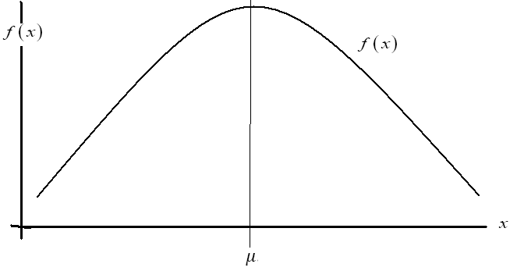

NORMAL DISTRIBUTION
One of the most commonly observed random variable has the bell shaped probability distribution (bell shaped curve) . It is known as the normal distribution.

Slide 4


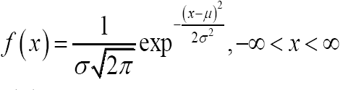
NORMAL DISTRIBUTION
It has two parameters of interest,
that is, the mean and variance.
It is symmetrical about the value of the mean.

Slide 5

NORMAL DISTRIBUTION
Where

Slide 6
NORMAL DISTRIBUTION
Moreover it can be proved that the constants- mean and standard deviation- appearing in the definition of the p.d.f are actually the expected value and the standard deviation of the random value X.

Slide 7
NORMAL DISTRIBUTION
However, to compute the values of probabilities using the formula is difficult if not impossible. In this case we use the standard normal distribution tables for computing the probabilities under the normal distribution.

Slide 8

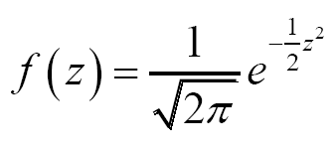
NORMAL DISTRIBUTION
The standard normal distribution use the fact that

Slide 9
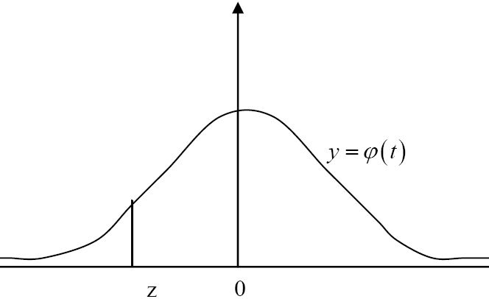

NORMAL DISTRIBUTION
Its curve is of the form

Slide 10
NORMAL DISTRIBUTION
Using the standard normal tables
Example 1
Find the probability that the random variable Z falls between -1.33 and +1.33

Slide 11
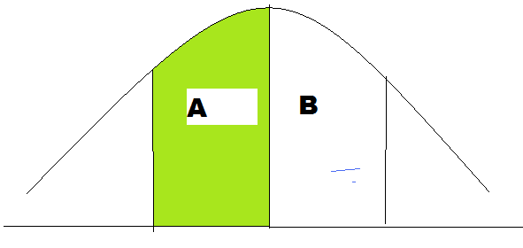
NORMAL DISTRIBUTION
Solution
P(-1.33<Z<1.33)= area A +area B

Slide 12
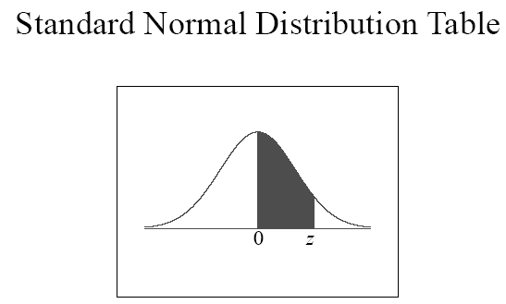
NORMAL DISTRIBUTION
Using the standard normal table for which the values
give the area from Zero to the point labelled Z as shown on the pictorial representation below.

Slide 13
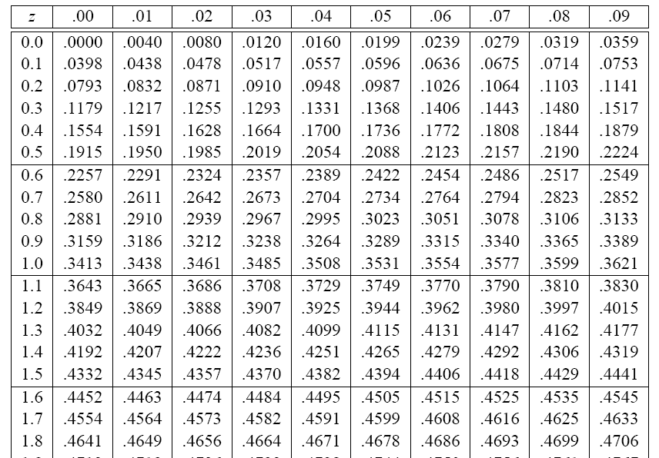
NORMAL DISTRIBUTION

Slide 14
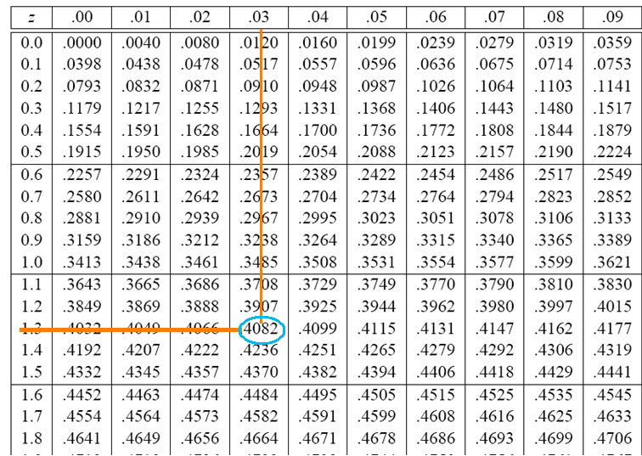
NORMAL DISTRIBUTION

Slide 15
NORMAL DISTRIBUTION
Therefore the value for P(-1.33<Z<1.33 is
0.4082+0.4082= 0.8164
Example 2
Find the probability that the random variable Z exceed 1.64

Slide 16
NORMAL DISTRIBUTION
Using the standard normal tables
Example 3
Find the probability that the random variable Z lies to the left of 0.67

Slide 17
NORMAL DISTRIBUTION
Using the standard normal tables for normal probabilities
Example 4
In an examination the average mark was 76.5 and the standard deviation was 9.5. If 15% of the class scored grade A and the marks are assumed to follow a normal distribution, what is the lowest possible grade A mark and the highest possible grade B mark?

Slide 18


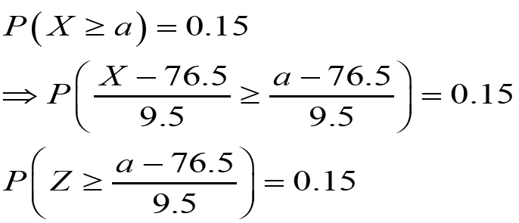
NORMAL DISTRIBUTION
Solution:

Slide 19
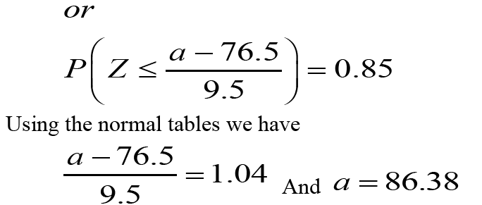

NORMAL DISTRIBUTION

Slide 20
NORMAL DISTRIBUTION
Example 5
A certain magazine sold in clubs in the US showed significant reduction in financial earnings in the last few years. The CEO has found that the mean monthly revenues for the various clubs around the country are $ 1.23 million with a standard deviation of $ 0.65 million. Assume that the distribution of the monthly earnings is normally distributed.

Slide 21
NORMAL DISTRIBUTION
If the revenues for one month were selected for any one of the clubs,
what is the probability it would exceed $ 1.3 million?
If the CEO wishes to single out for corrective actions clubs reporting receipts in the lowest 12 percent, what level of revenues must a club exceed not to receive this undesirable attention?

Slide 22
NORMAL DISTRIBUTION
Suppose that the diameter at breast height (in inches) of trees of a certain type is normally distributed with mean of 8.8 and standard deviation of 2.8.
what is the probability that the diameter of a randomly selected tree will be at least 10 inches?
what is the probability that the diameter of a randomly selected tree will be between 5 and 12 inches?
If a sample of size 20 is randomly selected from this forest what is the probability that the mean of the sample exceeds 9.5 inches in diameter?

Slide 23
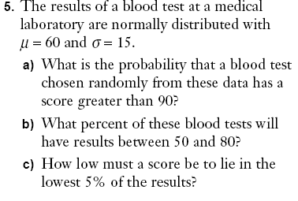
NORMAL DISTRIBUTION

Slide 24
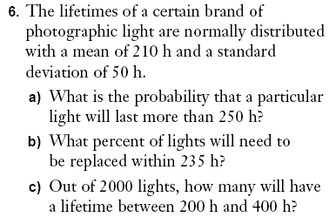
NORMAL DISTRIBUTION

Slide 25
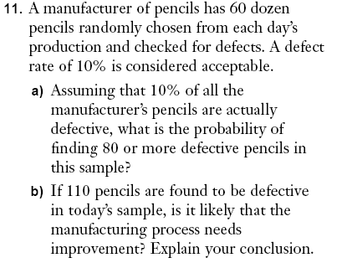
NORMAL DISTRIBUTION

Slide 26
NORMAL DISTRIBUTION
Exercise 13
The results of a blood test in a medical laboratory are normally distributed with a mean of 60 and variance 225
a). What is the probability that the a blood test chosen at random from these data has score greater than 90?

Slide 27
NORMAL DISTRIBUTION
Exercise 13 -continued
b). What percent of that blood test will have results between 50 and 80?
c). How low must a score be to lie in the lowest 5 % of these results?

Slide 28
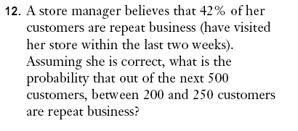
NORMAL DISTRIBUTION

Slide 29



EXPONENTIAL DISTRIBUTION

Slide 30





EXPONENTIAL DISTRIBUTION

Slide 31


EXPONENTIAL DISTRIBUTION

Slide 32
EXPONENTIAL DISTRIBUTION
Example 1
Suppose that the number of minutes required to serve a customer at a service counter has an exponential distribution with mean 2. Compute the probability that the time required to serve a single customer will exceed 4 minutes.

Slide 33
EXPONENTIAL DISTRIBUTION
Solution???

Slide 34
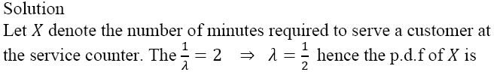
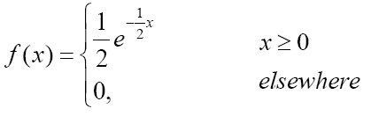

EXPONENTIAL DISTRIBUTION

Slide 35
EXPONENTIAL DISTRIBUTION
Example 2
The lifetime of TV tubes (in years) is an exponential r.v with mean 10. if Jim bought the TV set 10 years ago, what is the probability its tube will last another 10 years.

Slide 36
EXPONENTIAL DISTRIBUTION
Solution???

Slide 37
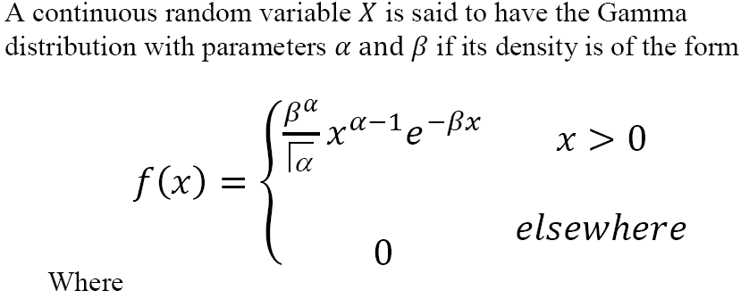

GAMMA DISTRIBUTION

Slide 38
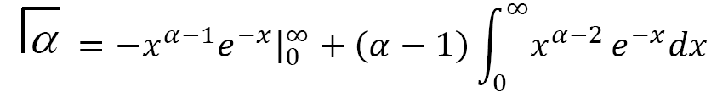





GAMMA DISTRIBUTION

Slide 39
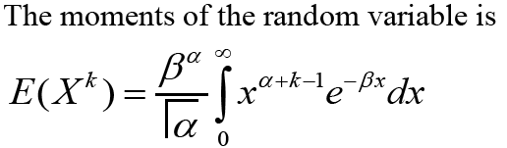




GAMMA DISTRIBUTION

Slide 40

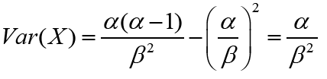

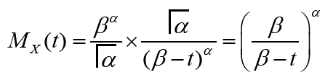

GAMMA DISTRIBUTION

Slide 41
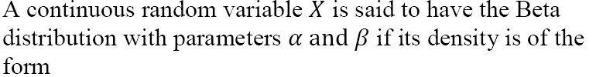
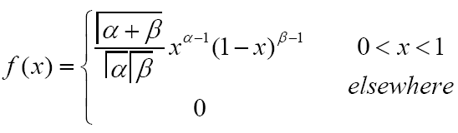
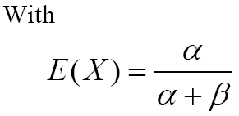
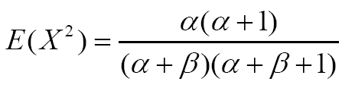
BETA DISTRIBUTION

Slide 42



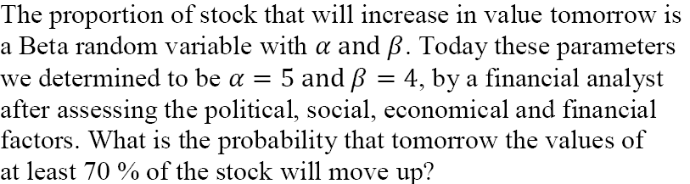
BETA DISTRIBUTION

Slide 43



BETA DISTRIBUTION

Slide 44

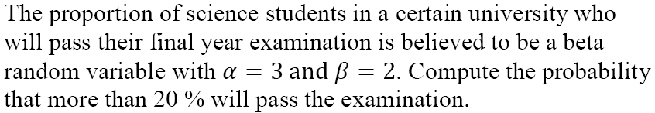
BETA DISTRIBUTION

Slide 45
BETA DISTRIBUTION
Solution ......???

Slide 46
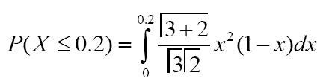

BETA DISTRIBUTION

Slide 47
12:01:43 PM
END OF LECTURE 7

